Slide 1

EU27 Chemical Industry: Latest Developments
(Q3-2025)
To replace the background image:
1/Go to Slide Master (Menu “View”)
2/Right-click on the image
3/Select “Replace image…”
4/Close the Slide Master
Dr Moncef Hadhri
Chief Economist
mha@cefic.be

Slide 2
EU27 chemical business is struggling
The current situation in the chemical industry is worrying. Chemical companies are facing a very difficult global economic context. Energy costs in Europe remain among the highest in the world, and demand is still disappointing.
The sector continues to face fierce competition, particularly from China. Foreign trade, which has always been a driving force of the European economy, is not significantly improving.
The lack of action regarding energy prices remains a core concern of the sector. In addition, the recipes that worked in the past seem to have reached their limits: Europe is suffering from being an open market and from its unmatched level of regulation, to the point that Europe has now entered a critical phase. The European chemical sector is a reflection of those patterns, struggling to export more to the international market and facing a significant wave of imports.
Uncertainty continues to penalise investment, and forecasts for 2025-2026 are poor. The number of closures in the chemical sector is leading to deindustrialisation, to the benefit of countries offering a cost advantage.

Slide 3
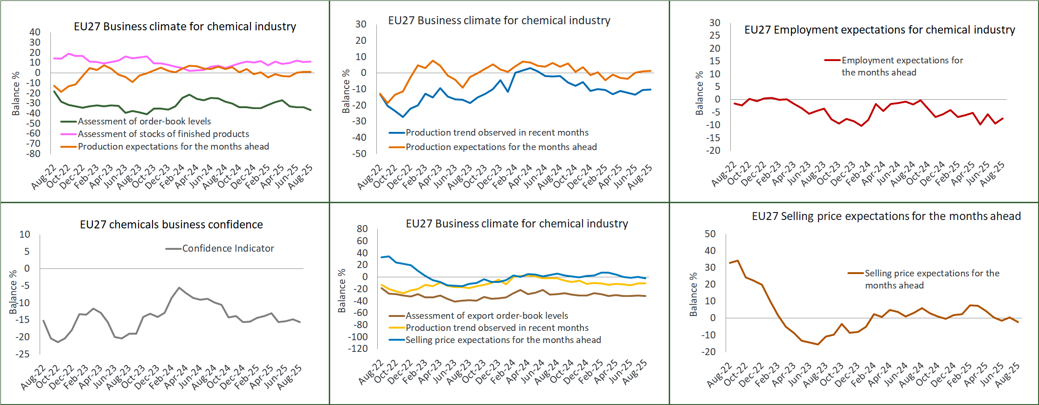
EU27 chemicals business confidence remains weak in 2025 (Jan-Aug)
Source: EU Commission business and consumer survey results: Answers obtained from the surveys are aggregated in the form of balances, constructed as the difference between the percentages of respondents giving positive and negative replies.
Notes:
EU27 chemicals business confidence remains weak in 2025 (Jan-Aug)
According to the latest EU Commission business and consumer survey, confidence in the EU27 chemical industry significantly deteriorated in 2025 (Jan-Aug) compared to the same period of 2024. Among the largest EU27 economies, the confidence indicator declined sharply in Germany (-8.5) and France (-7.7), while Belgium saw a modest improvement (+1.9). Confidence deteriorated significantly in Poland (-5.3), Italy (-5.2), Spain (-5.1), and the Netherlands (-4.8). The EU27 chemicals business environment has been facing a limited demand since March 2022.

Slide 4
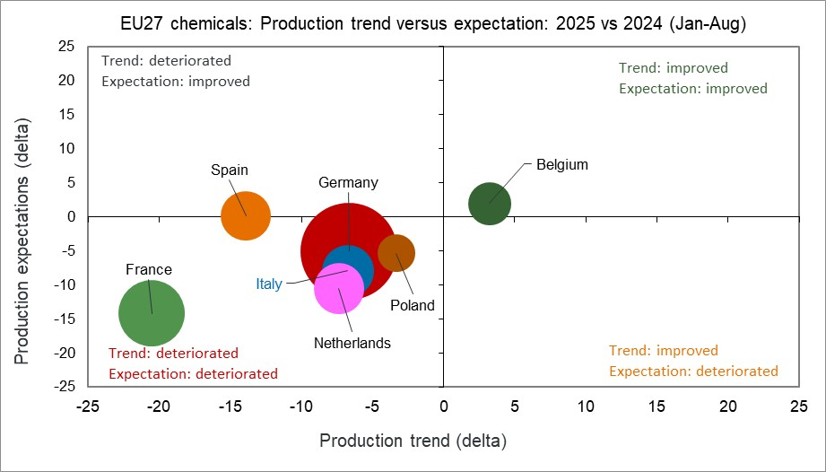
EU27 chemicals business sentiment deteriorated in 2025 (Jan-Aug)
Source: EU Commission business and consumer survey results: Answers obtained from the surveys are aggregated in the form of balances, constructed as the difference between the percentages of respondents giving positive and negative replies. Size of bubbles is calculated by taking into account the country contribution of chemical sales for 2024.
Notes:
EU27 chemicals business sentiment deteriorated in 2025 (Jan-Aug)
The chart below provides a snapshot of the business sentiment in the chemical industry, comparing the first eight months of 2025 to the same period in 2024. Business sentiment is based on two parameters from the European Commission survey data: (i) 'Production trend observed in recent months, and (ii) production expectations for the months ahead. The results align with expectations: most key countries fall within the “red box”, indicating a deterioration in 2025 compared to 2024 in both production trends and future expectations.

Slide 5
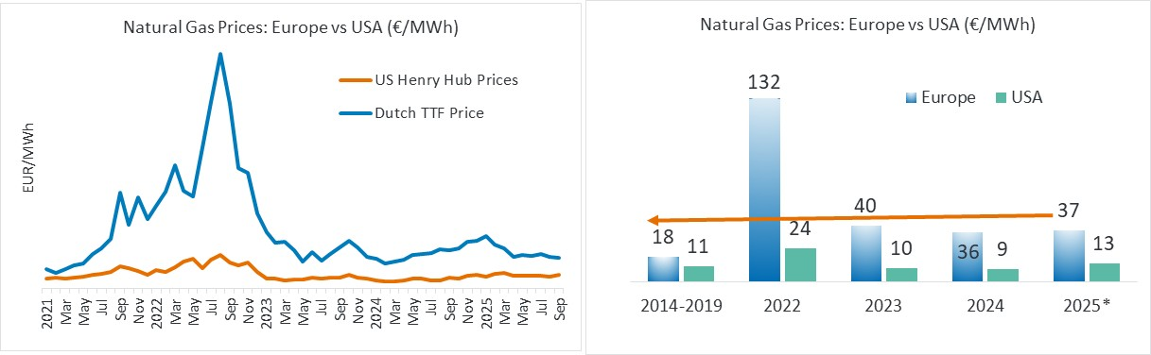
European gas prices remain above the pre-crisis levels
Gas prices in Europe in 2025 (Jan-Sep): 2.1 times higher than pre-crisis levels (2014-2019)
Compared to the USA, the gas price in Europe (Jan-Sep 2025) is 2.9 times higher, leaving Europe at a competitive disadvantage.
Source ICE Dutch TTF Natural Gas Futures Historical Prices - Investing.com and INSEE Oil Prices data and ICIS
Notes:
European gas prices remain above the pre-crisis levels
The chemical industry is energy-intensive using about 25 to 50% of the natural gas it purchases as raw material, while the rest is used to generate steam and power for plants and processes. Chemicals are therefore highly impacted by gas prices. Access to reliable and competitive energy sources is essential to maintain competitiveness. Upstream basic organic and inorganic chemicals, such as ethylene, propylene, ammonia, chlorine, and alkalis, are based on energy-intensive processes. At global level, gas prices in Europe were 2.9 times higher than those in the USA, placing Europe at a competitive disadvantage. The gap in natural gas prices between Europe and its competitors is projected to remain substantial between 2025 to 2030, further weakening the European industry’s competitive position in global chemical markets.

Slide 6
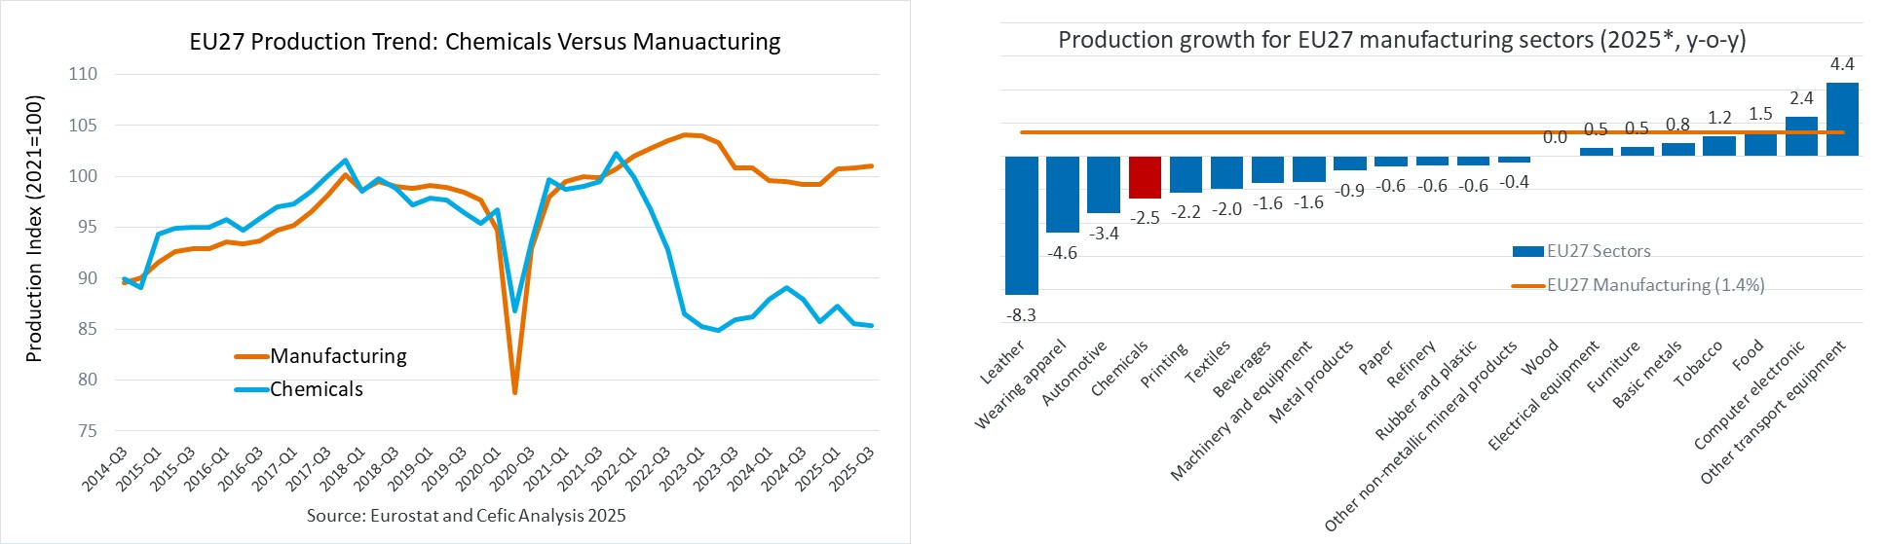
EU27 chemical demand: First nine months of 2025 disappoint
  EU27 chemical output* remains 10% below the pre-crisis levels (2014 to 2019)
Source: Cefic Analysis based on Eurostat Data, *2025 (Jan-Sep)
Notes:
EU27 chemical demand: First eight months of 2025 disappoint
From January to August 2025, output across the EU27 manufacturing sector rose by 1.3% compared to the same period in 2024. However, most downstream users of chemicals reported a decline in output. For instance, the automotive sector is still experiencing a significant decline of about 4.0%. The EU27 chemical industry itself reported a significant output decrease of 2.8%, far below the overall EU27 manufacturing average. The output of the EU27 chemical industry remains 10% below the pre-crisis levels of 2014 to 2019. Unfortunately, no strong positive changes have been observed so far and business expectations for most downstream users are still not encouraging.

Slide 7
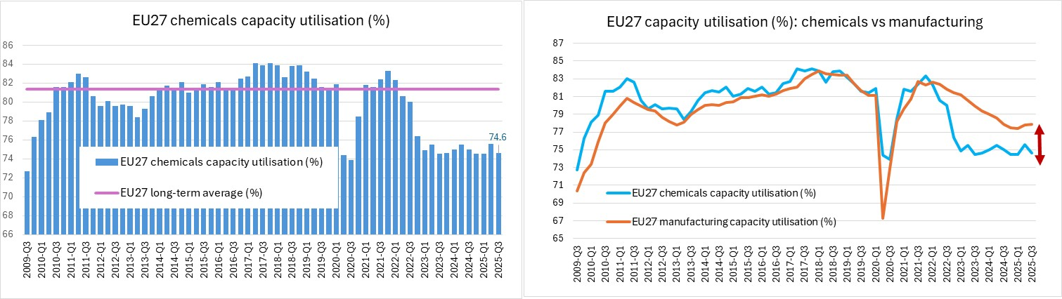
EU27 chemicals capacity utilisation remains steadily low
EU27 chemicals capacity utilisation slightly
increased in Q3-2025
EU27 chemicals capacity utilisation remains well below
the manufacturing’s levels
  EU27 chemicals operating at 9.5% below pre-crisis capacity (2014–2019)
Source: Cefic Analysis based on Eurostat Data
Notes:
EU27 chemicals operating at 9.5% below pre-crisis capacity (2014–2019)
The EU27 chemical industry is still lacking a strong domestic demand since 2022, and production data confirm the view that the European chemical industry is at a breaking point. About approximately 15 million metric tons of announced capacities were set to be closed in Europe between 2023 and 2025. This number of site closures is well above the historical level observed in Europe in recent years. The chart below reports a decrease of capacity in the EU27 chemical industry from 75.6% in Q2-2025 to 74.6% in Q3-2025, in comparison with a long-term average of 81.3%.

Slide 8
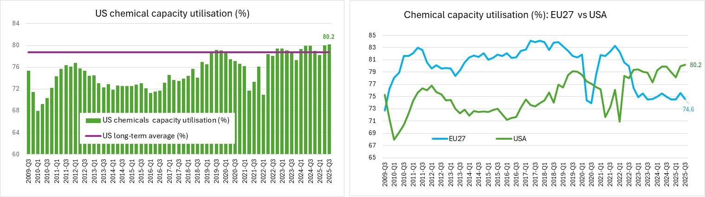
US chemicals capacity utilisation remains significantly high
US chemicals capacity utilisation slightly
increased in Q3-2025
US chemicals capacity utilisation remains well above
the long-term average (1991-2022)
Source: Cefic Analysis based on Eurostat Data

Slide 9
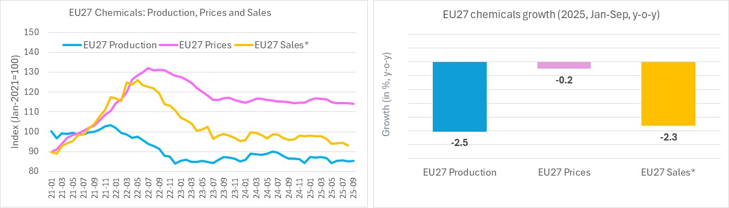
Weak demand continues to weigh on EU27 chemical sales
Source: Cefic Analysis based on Eurostat Data, Nace 20 only, *2025 (Jan-Aug)
Notes:
Weak demand continues to weigh on EU27 chemicals sales
In 2025, EU27 chemical prices were at the same level as in 2024. Chemical sales in value decreased by 2.1% in the first half of 2025 compared to the same period in 2024. The high level of uncertainty is impacting deeply the European business community. Given the lack in demand growth, the European chemical industry production volumes have still not recovered. The ongoing low demand continues to weigh on EU27 chemical sales.

Slide 10
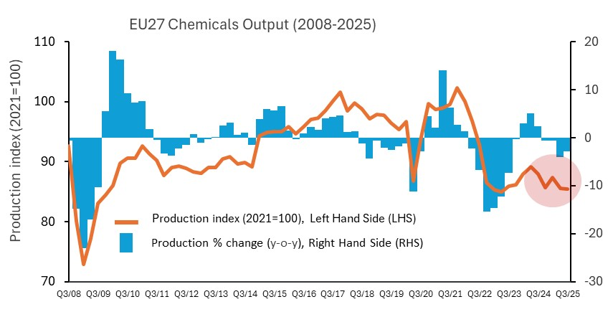
2025: EU27 chemicals production 2.5% below 2024 levels (Jan-Sep)
Source: Cefic Analysis based on Eurostat Data, *2025 (Jan-Sep)
Notes:
January to August 2025: EU27 chemicals production 2.8% below 2024 levels
Data analysis shows that leading EU27 countries experienced different growth rates of chemical production during the first eight months of 2025 compared to the same period of 2024. The Netherlands registered a decline of 6.5%. France saw its production decrease by 5.0%. Spain reported a decrease of less than 1%. Germany and Italy posted a decrease of 3.6% and 1.7% respectively. Belgium benefited from a 1.2% increase. Poland registered a decline of 2.5%. Chemical production trends by country show a fragmented Europe. The economic environment in which European chemical companies are operating in 2025 is highly uncertain. The global economic outlook for 2025 is not very positive. EU27 chemicals output is expected to decrease by more than 2.0% in 2025, down from 2.5% growth achieved in 2024.

Slide 11
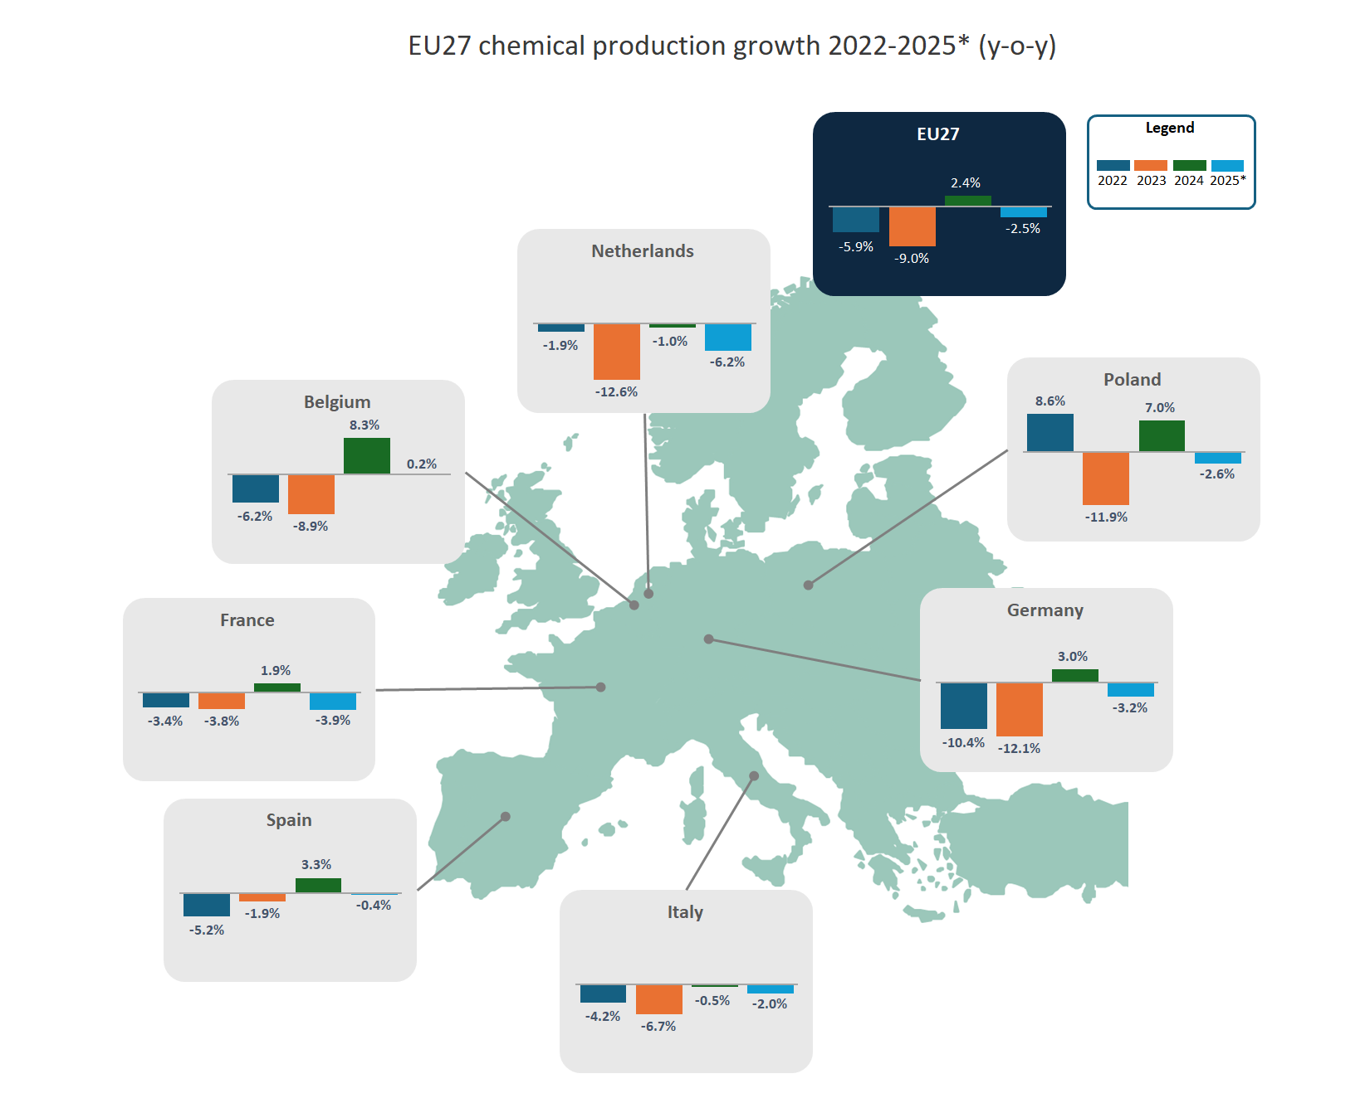
2025: EU27 chemicals production 2.5% below 2024 levels (Jan-Sep)
Source: Cefic Analysis based on Eurostat Data, *2025 (Jan-Sep)
Notes:
January to August 2025: EU27 chemicals production 2.8% below 2024 levels
Data analysis shows that leading EU27 countries experienced different growth rates of chemical production during the first eight months of 2025 compared to the same period of 2024. The Netherlands registered a decline of 6.5%. France saw its production decrease by 5.0%. Spain reported a decrease of less than 1%. Germany and Italy posted a decrease of 3.6% and 1.7% respectively. Belgium benefited from a 1.2% increase. Poland registered a decline of 2.5%. Chemical production trends by country show a fragmented Europe. The economic environment in which European chemical companies are operating in 2025 is highly uncertain. The global economic outlook for 2025 is not very positive. EU27 chemicals output is expected to decrease by more than 2.0% in 2025, down from 2.5% growth achieved in 2024.

Slide 12
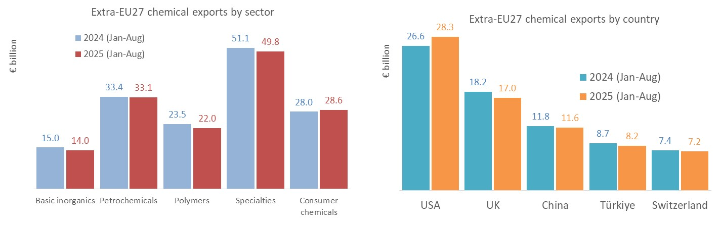
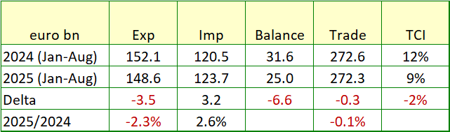
January to August 2025: EU27 chemical exports value below 2024 levels
Source: Cefic Analysis based on Eurostat Data, Nace 20 only
Notes:
January to July 2025: EU27 chemical exports value below 2024 levels
From January to July 2025, EU27 chemical exports decreased by 0.7% in 2025 in comparison to the same period in 2024. The EU27 chemicals exports amounted to €133.4 bn in the first seven months of 2025, down by €1.0 bn compared to 2024. With €26.3 bn, USA is the primary source of exports of the EU27 area for chemicals, followed by the UK (€15.0 bn) and China (€10.4 bn). With €44.6 bn, specialty chemicals is the largest export sector followed by petrochemicals (€30.2 bn) and consumers chemicals (€25.4 bn).

Slide 13
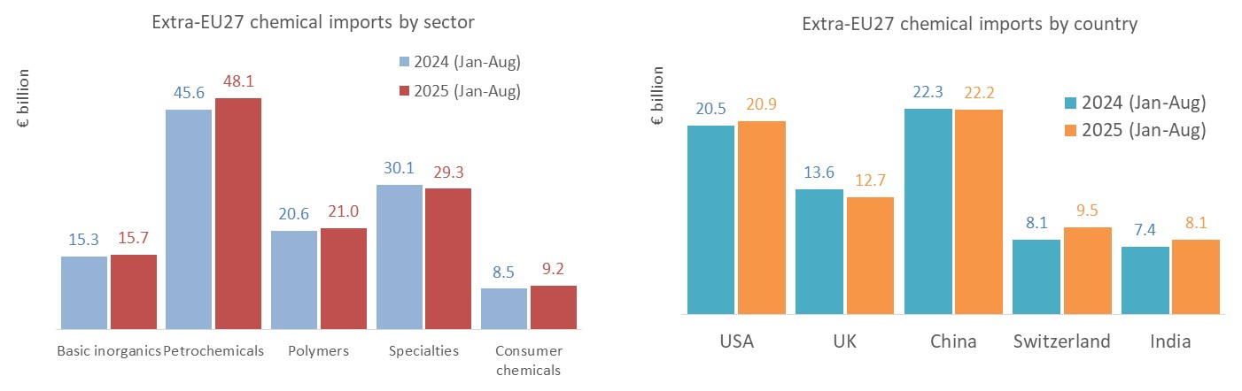
January to August 2025: EU27 chemical imports value above 2024 levels
Source: Cefic Analysis based on Eurostat Data, Nace 20 only
Notes:
January to July 2025 : EU27 chemicals imports value 4.3% above 2024 levels
From January to July 2025, EU27 chemical imports increased by 4.0% in 2025 in comparison to the same period in 2024. The EU27 chemical industry import amounted to €110.1 bn in the first seven months of 2025, up by €4.3 bn compared to 2024. With €20.1 bn, China is the primary source of imports of the EU27 area for chemicals, followed by the USA (€18.7 bn) and the UK (€11.3 bn). With €42.8 bn, petrochemicals is the largest import sector followed by specialty chemicals (€25.9 bn) and polymers (€18.8 bn). 2025 data analysis shows an increase in import values for all sectors except for specialty chemicals compared to 2024 (Jan-July).

Slide 14
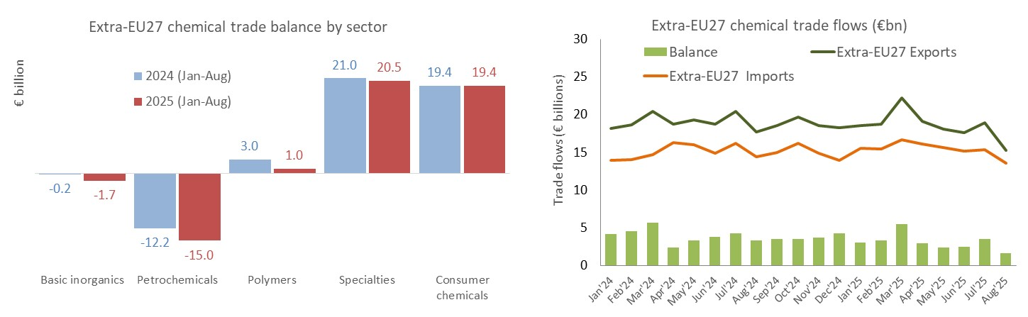
January to August 2025: EU27 chemicals trade surplus in value below 2024 levels
Source: Cefic Analysis based on Eurostat Data, Nace 20 only
Notes:
January to July 2025: EU27 chemicals trade surplus in value below 2024 levels
From January to July 2025, EU27 chemical exports decreased by 0.7% in 2025 in comparison to the same period in 2024, whereas EU27 chemical imports increased by 4.0%. The EU27 chemicals trade surplus amounted to €23.3 bn in the first seven months of 2025, down by €5.3 bn compared to 2024 (-18.5%). With €12.7 bn, petrochemicals is generating the largest trade deficit, followed by basic inorganics (€1.6 bn). By contrast, specialty chemicals and consumers chemicals continue to generate a trade surplus of more than €17 bn each in 2025 (Jan-July).

Slide 15
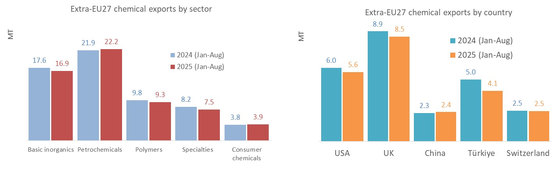
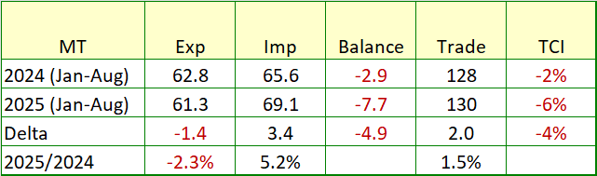
January to August 2025: EU27 chemical exports volume below 2024 levels
Source: Cefic Analysis based on Eurostat Data, Nace 20 only
Notes:
January to July 2025 : EU27 chemicals exports volume 1.5% below 2024 levels
From January to July 2025, EU27 chemical exports decreased by 0.835 million tons in 2025 in comparison to the same period in 2024. The EU27 chemicals exports amounted to 54.0 million tons bn in the first seven months of 2025, down from 54.8 million tons in 2024. With 7.6 million tons, UK is the primary source of exports of the EU27 area for chemicals, followed by USA (5.0 mt) and Türkiye (3.6 mt).

Slide 16
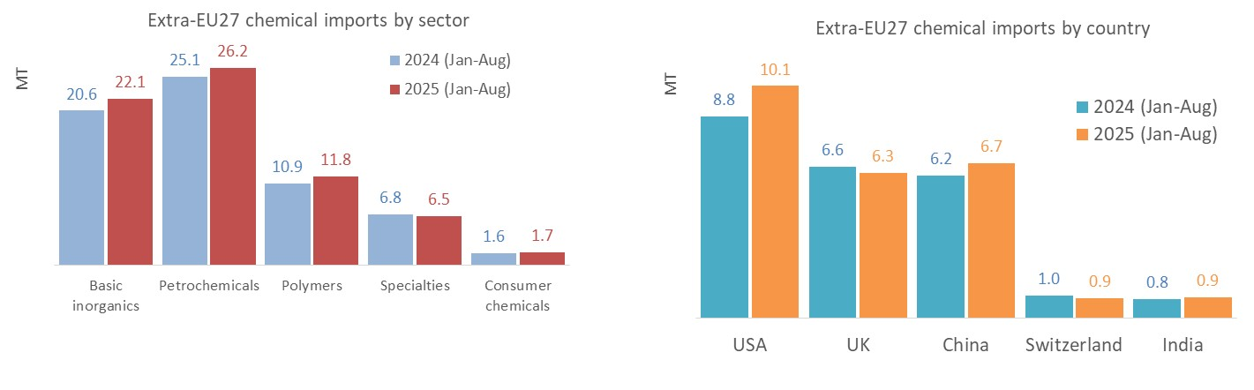
January to August 2025: EU27 chemical imports volume above 2024 levels
Source: Cefic Analysis based on Eurostat Data, Nace 20 only
Notes:
January to July 2025: EU27 chemicals imports volume 7.1% above 2024 levels
From January to July 2025, EU27 chemical imports increased by 4.1 million tons in 2025 in comparison to the same period in 2024. The EU27 chemicals exports amounted to 61.1 million tons in the first seven months of 2025, up from 57.0 million tons in 2024. With 8.8 million tons, USA is the primary source of imports of the EU27 area for chemicals, followed by China (5.8 mt), and the UK (5.6 mt).

Slide 17
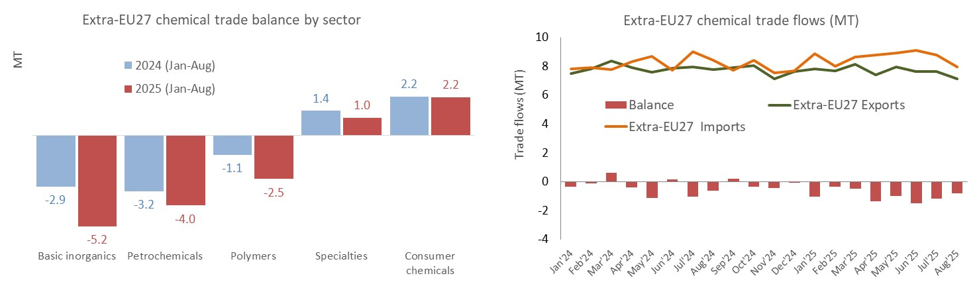
January to August 2025: EU27 trade deficit in volume above 2024 levels
Source: Cefic Analysis based on Eurostat Data, Nace 20 only
Notes:
January to July 2025: EU27 chemicals trade deficit up by 4.9 million tons
The EU27 chemicals trade deficit amounted to 7.1 million tons in the first seven months of 2025, up by 4.9 million tons compared to 2024. With 5.1 million tons, basic inorganics generated the largest trade deficit, followed by petrochemicals (3.4 mt) and polymers (2.2 mt). Specialty chemicals and consumers chemicals continue to generate a trade surplus of more than 1 million tons each in 2025 (Jan-July).

