Slide 1

EU27 Chemical Industry: Latest Developments:
Ongoing weak demand, export improvement, but low chemical business confidence
^{15th} October 2024
Dr Moncef Hadhri
Economic Affairs
mha@cefic.be

Slide 2
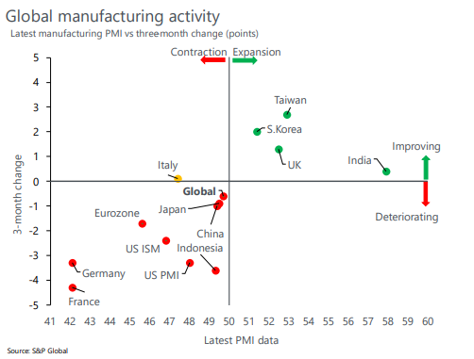
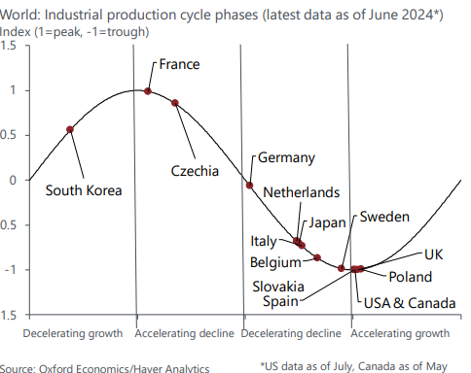
Worldwide industrial growth still sluggish
Despite pockets of strength, worldwide industrial growth still sluggish. The UK continues to be the key exception: the manufacturing PMI rose to 52.5.
2024 is seen* as a transition year for global industry, bridging the regional stagnations and contractions of 2022/2023 with a more solid expansion coming in 2025
Source: *Oxford Economics Monthly Report (August 2024)
Notes:
We continue to see 2024 as a transition year for global industry, bridging the regional stagnations and contractions of 2022/2023 with a more solid expansion coming in 2025.
• European production partially recovered in June after a dismal May. Monthly growth (excluding Ireland) came in at 0.6%, with France and Germany both partially clawing back May’s steep falls.
Eurozone manufacturing PMIs continue to be bleak:
the August flash readings uniformly deteriorated, with Germany and France coming in at 42.1. France’s reading, which has generally outperformed Germany’s over the past months, was particularly worrying as it tied December 2023 for the worst result since the onset of the Covid-19 pandemic.
The UK continues to be the key exception: the manufacturing PMI rose to 52.5. This is in line with production as output has slowly rising after bottoming out in October. There are some commonalities with the eurozone but the UK appears to be ahead in the recovery of machinery and fabricated metals production, which is still searching for a bottom in Europe.
• Industrial growth once again matched our expectations in China, slowing to 5.1% y/y in July, down from 5.3% in June. We expect that this weakening will continue: export growth, which helped boost industry in the first half of the year, will likely slow in the coming months as cost competitiveness, which has been helping manufacturing sales abroad but has been weighing on profitability, will likely prove unsustainable.

Slide 3
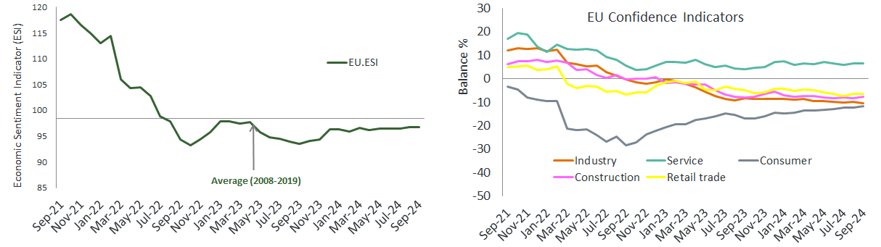
Economic sentiment indicator (ESI) remained stable in the EU27 area
Among the largest EU economies, the ESI worsened markedly in France and Germany, while it improved significantly in Poland, Spain, Italy and, more moderately, in the Netherlands.
Confidence improved in construction and among consumers, offset by a decrease in industry confidence. Confidence in services and retail trade remained stable
Source: EU Commission business and consumer survey results: Answers obtained from the surveys are aggregated in the form of balances, constructed as the difference between the percentages of respondents giving positive and negative replies.
Notes:
In September 2024, the Economic Sentiment Indicator (ESI) remained broadly stable in both the EU (±0.0 points at 96.7) and the euro area (-0.3 points to 96.2). 1 The Employment Expectations Indicator (EEI) remained broadly unchanged as well in both areas (EU: +0.3 points to 100.0, euro area: +0.1 points to 99.5). While the EEI is at or very close to its long-term average of 100, the ESI continues to score below that reference value. The steadiness of the ESI in the EU resulted from improved confidence in construction and among consumers, offset by a decrease in industry confidence. Confidence in services and retail trade remained broadly stable. For the largest EU economies, the ESI worsened markedly in France (-1.4) and Germany (-1.2), while it improved significantly in Poland (+2.0), Spain (+1.9), Italy (+1.2) and, more moderately, in the Netherlands (+0.5).

Slide 4
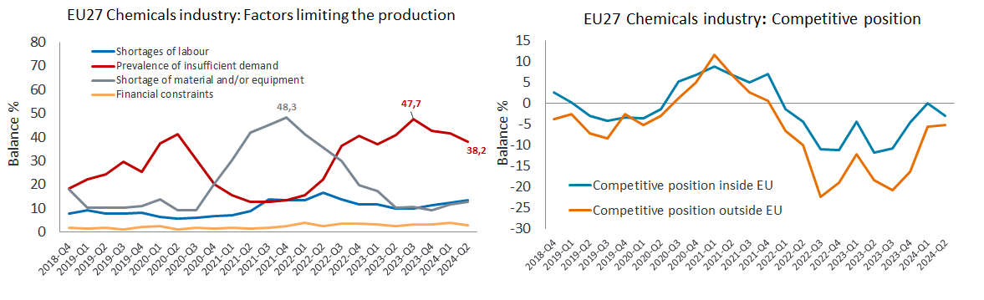
The percentage of managers indicating insufficient demand as a factor limiting chemical activity decreased
The percentage of managers indicating insufficient demand as a factor limiting chemical activity decreased significantly in Q2-2024, but remained high (38%)
Competitive positions of the EU27 chemicals industry significantly increased since Q3-2023, but still well below
the pre-crisis levels
Source: EU Commission business and consumer survey results: Answers obtained from the surveys are aggregated in the form of balances, constructed as the difference between the percentages of respondents giving positive and negative replies.

Slide 5
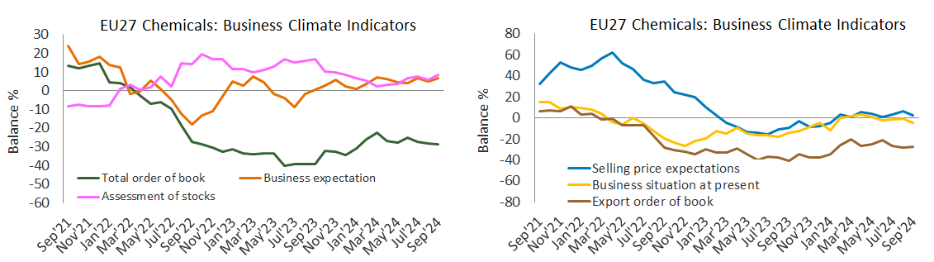
EU27 chemicals business environment continue to face a limited demand since March 2022.
The managers’ opinion on the current level of overall order books continue to decrease. The negative digits reflect the lack of demand for the chemical industry.
The confidence indicator of the EU chemical industry worsened in Sep 2024 and remains well below the pre-crisis levels.
Source: EU Commission business and consumer survey results: Answers obtained from the surveys are aggregated in the form of balances, constructed as the difference between the percentages of respondents giving positive and negative replies.
Notes:
The current level of overall order books shows a slight deterioration in July
The managers’ opinion on the current level of overall order books shows a slight downturn in July 2024 compared to June 2024. It is still in negative digits reflecting the lack of demand for the chemical industry. The ongoing destocking trend came to the end since March 2024. We see in July 2024 the fourth upturn in the stock level after six months of decline. Data on managers’ production expectations shows a slight improvement in July after three months of decline. According to the latest EU27 business and consumer survey, the uncertainty indicator decreased in July. Managers' uncertainty about their future business situation in services and construction and consumers' uncertainty about their future financial situation decreased. By contrast, business uncertainty increased slightly in industry and retail trade. To sum up, the EU27 chemicals business environment shows slight downturn, and is still facing a limited demand since March 2022. The recovery is more necessary than ever.

Slide 6
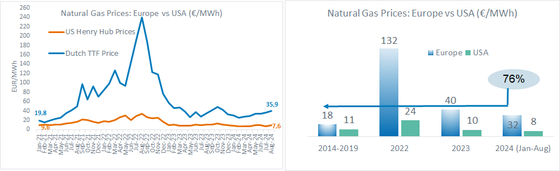
European gas prices in 2024 (Jan-Aug): 76% above the pre-crisis levels
Energy costs are the Achilles’ heel of the European chemical industry, especially when compared to the United States and the Middle East
Compared to the USA, the gas price in Europe (August 2024) is 4.3 times higher, leaving Europe at a competitive disadvantage
Source: : ICE Dutch TTF Natural Gas Futures Historical Prices - Investing.com and INSEE Oil Prices data
Notes:
Energy costs are the Achilles’ heel of the European chemical industry, especially when compared to the United States and the Middle East. This, along with high feedstock costs, is causing the industry to weaken further its competitive position in global chemical markets. The current gas prices in the EU (Jan-July 2024) are 70% above the pre-crisis level (2014-2019). Compared to the USA, the gas price in Europe (July 2024) is 4.7 times higher, leaving Europe at a competitive disadvantage.

Slide 7
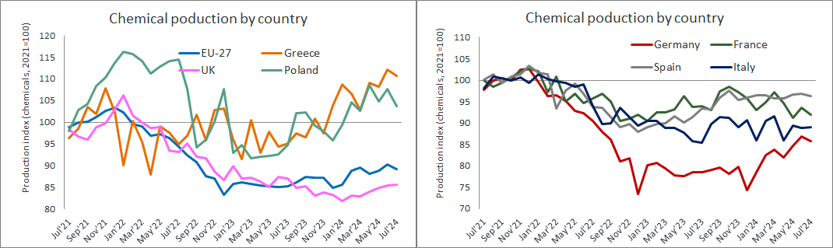
Main EU27 countries showed better production results in 2024 (Jan-July)
2024 showed better results than 2023. However, Challenges such as weak demand and high operational costs continue to weigh on EU27 chemical companies.
Germany, saw its production increase by 5.7% in 2024 (Jan-July). Spain showed the highest growth. France and Italy posted a modest increase of less than 1%.
Source: Eurostat and Cefic Analysis 2024
Notes:
The leading EU27 countries experienced improved chemical production during the first seven months of 2024. Germany, which accounts for one-third of EU27 chemical sales (33% in 2023), saw its production increase by 5.7% in 2024 (Jan-July). Spain showed the highest growth among the major economies, with a 6.2% increase, while Belgium' 4.2% growth exceeded the overall EU27 rate. The Netherland registered a rise of 2.3%. France and Italy posted a modest increase of less than 1%. Greece and Poland reported an increase of more than 10%. The UK continue to improve since January 2024 but remained below the 2023 levels. Although chemical output in the biggest EU27 economies began 2024 stronger than anticipated, the 3.6% year-on-year growth seen across the EU27 in the first seven months of 2024 should be viewed cautiously. Challenges such as weak demand and high operational costs continue to weigh on European chemical companies.

Slide 8
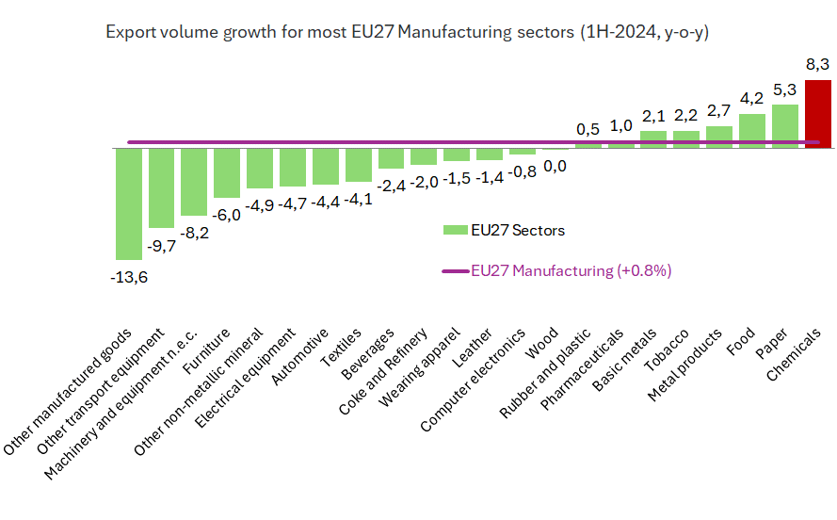
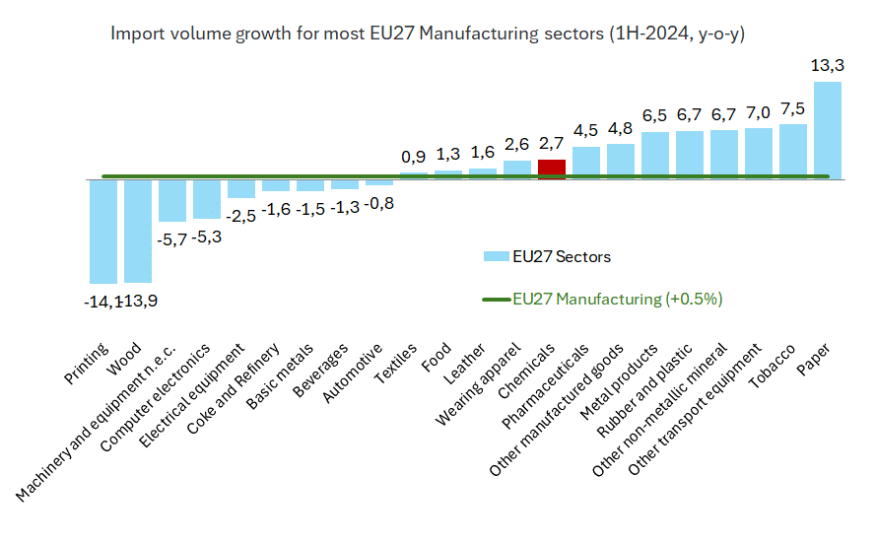
EU27 chemicals trade (volume) up by 5.4% in 2024 (Jan-June)
EU27 chemical exports reached 46.8 (million tonnes), in 1H-2024. Chemicals reported the largest export growth among the manufacturing sectors (+8.3%)
EU27 chemical imports reached the volume of 47.8 (million tonnes), in 1H-2024, slightly up from 46.3 MT in 1H-2023 (+2.7%).
Source: Eurostat and Cefic Analysis 2023

Slide 9
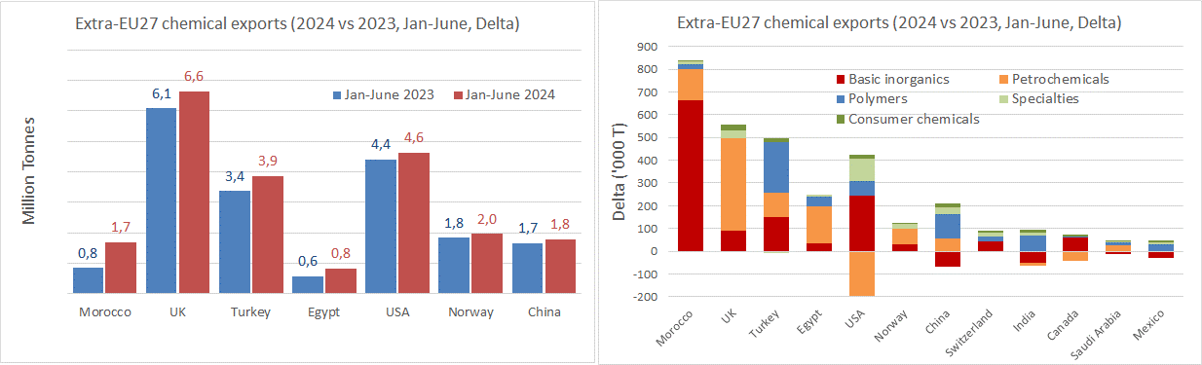
Morocco and UK markets contributed largely to additional EU27 chemicals exports in 2024 (Jan-June)
EU27 exports to Morocco, UK, Turkey, Egypt and the USA contributed largely to these additional exports in 2024. The top 3 biggest increases in exports outside the EU27 are attributable to Morocco (basic inorganics), UK (petrochemicals), and Turkey (polymers).
Source: Eurostat and Cefic Analysis 2024

Slide 10
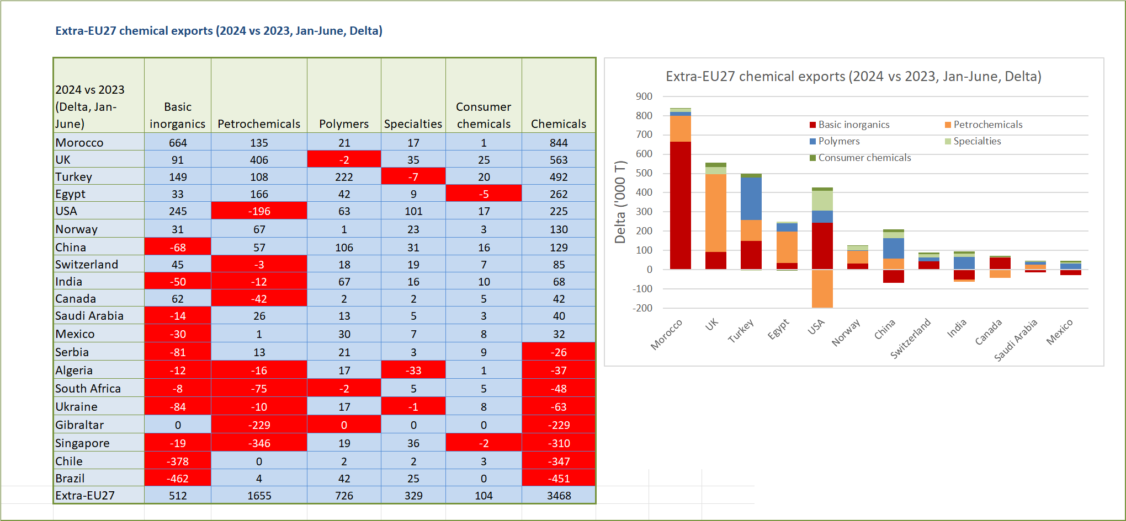
Morocco and UK markets contributed largely to additional EU27 chemicals exports in 2024 (Jan-June)
Source: Eurostat and Cefic Analysis 2024

Slide 11
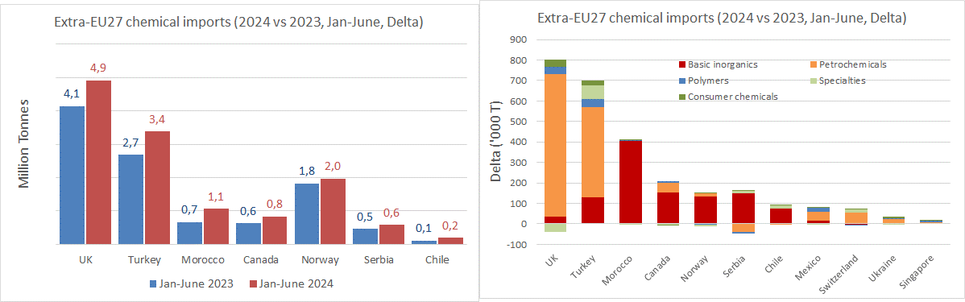
UK and Turkey contributed largely to the increase in EU27 chemicals imports in 2024 (Jan-June)
EU27 imports from UK, Turkey, Morocco, Canada and Norway contributed largely to these additional imports in 2024. The top 3 being the UK (petrochemicals), Turkey (petrochemicals), and Morocco (basic inorganics).
Source: Eurostat and Cefic Analysis 2024

Slide 12
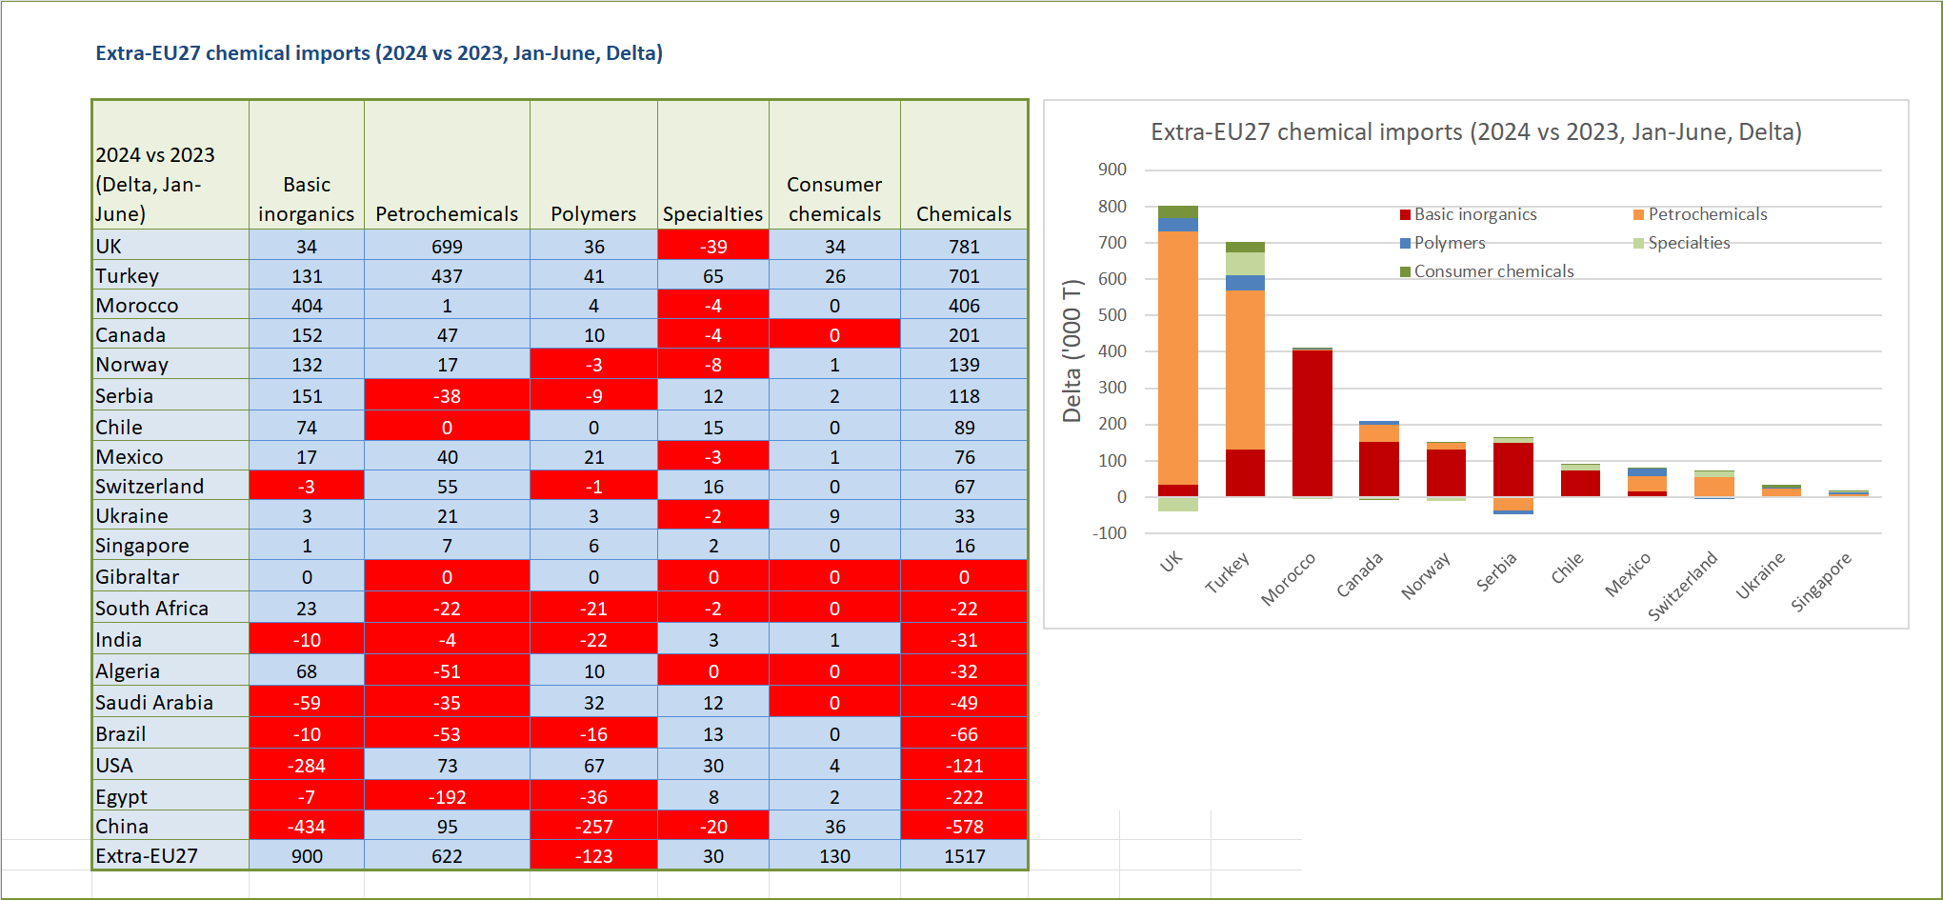
UK and Turkey contributed largely to the increase in EU27 chemicals imports in 2024 (Jan-June)
Source: Eurostat and Cefic Analysis 2024

Slide 13
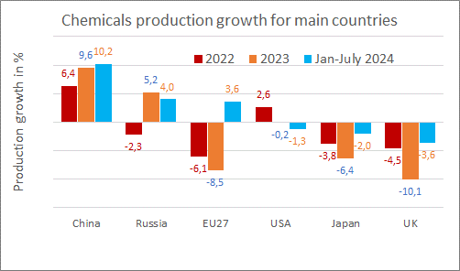
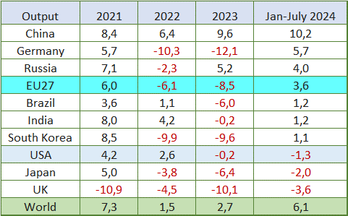
Global chemicals production, up by 6.1% in 2024 (Jan-July)
The chemical output in 2024 shows a notable recovery for several major economies compared to the previous year (Jan-July)
China continued its strong growth, rising from 9.6% in 2023 to 10.2% in the first seven months of 2024.
Source: Eurostat and Cefic Analysis 2024
Notes:
Global chemicals production, up by 6.1% in 2024 (Jan-July)
The chemical output in 2024 shows a notable recovery for several major economies compared to the previous year: China continued its strong growth, rising from 9.6% in 2023 to 10.2% in the first seven months of 2024. Germany, which saw significant declines in 2022 and 2023 (-10.3% and -12.1% respectively), rebounded with 5.7% growth in 2024 (Jan-July). Russia maintained positive growth, moving from 5.2% in 2023 to 4.0% in 2024.The EU27 region also reversed its negative trend, improving from -8.5% in 2023 to 3.6% in 2024. Brazil, India, and South Korea showed modest growth in 2024 after experiencing either stagnation or decline in 2023. The USA and Japan experienced a slight decline in 2024 (Jan-July) after maintaining relatively stable outputs in 2023. The UK continued to struggle, with chemical output dropping further to -3.6% in 2024 (Jan-July), following sharp declines in the previous years. Overall, global chemical output increased from 2.7% in 2023 to 6.1% in 2024 (Jan-July), reflecting a broader industry recovery.

Slide 14
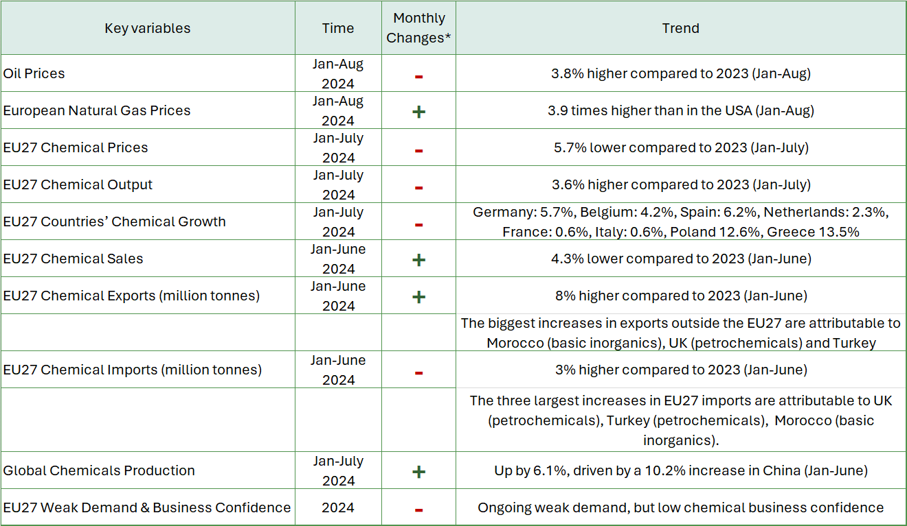
Summary table: Ongoing weak demand, export improvement, but low chemical business confidence
Source: Eurostat and Cefic Analysis 2024,*Monthly changes: compares a metric from the latest monthly data available to the previous month of the same year:
e.g. (Aug-2024 vs July 2024). This method helps to see if the monthly situation is getting better (+), staying the same (0), or getting worse (-)
Notes:
Global chemicals production, up by 6.1% in 2024 (Jan-July)
The chemical output in 2024 shows a notable recovery for several major economies compared to the previous year: China continued its strong growth, rising from 9.6% in 2023 to 10.2% in the first seven months of 2024. Germany, which saw significant declines in 2022 and 2023 (-10.3% and -12.1% respectively), rebounded with 5.7% growth in 2024 (Jan-July). Russia maintained positive growth, moving from 5.2% in 2023 to 4.0% in 2024.The EU27 region also reversed its negative trend, improving from -8.5% in 2023 to 3.6% in 2024. Brazil, India, and South Korea showed modest growth in 2024 after experiencing either stagnation or decline in 2023. The USA and Japan experienced a slight decline in 2024 (Jan-July) after maintaining relatively stable outputs in 2023. The UK continued to struggle, with chemical output dropping further to -3.6% in 2024 (Jan-July), following sharp declines in the previous years. Overall, global chemical output increased from 2.7% in 2023 to 6.1% in 2024 (Jan-July), reflecting a broader industry recovery.

