Slide 1

Discover the Latest Updates and Features of the Responsible Care Self-Assessment Webtool
To replace the background image:
1/Go to Slide Master (Menu “View”)
2/Right-click on the image
3/Select “Replace image…”
4/Close the Slide Master

Slide 2
Discover the Latest Updates and Features of the Responsible Care Self-Assessment Webtool
To replace the background image:
1/Go to Slide Master (Menu “View”)
2/Right-click on the image
3/Select “Replace image…”
4/Close the Slide Master

Slide 3
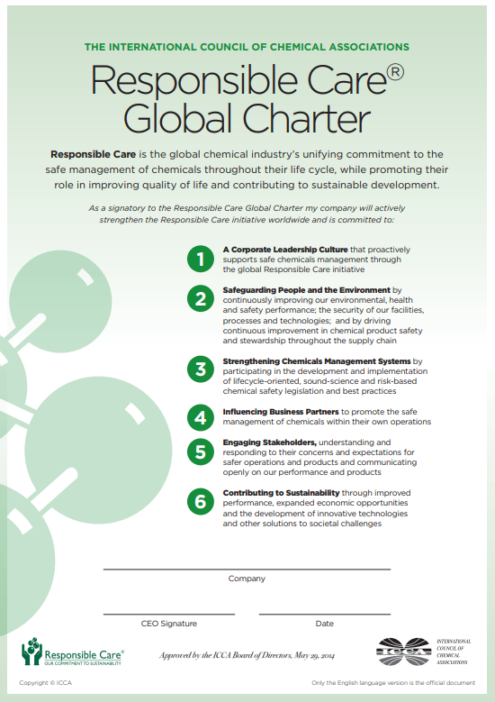




A successful programme in Europe and across the world!
Responsible Care has a history of
30+
years
guiding the continuous improvement of chemical safety and performance excellence
across
62
associations
70
economies
Spanning
600
With around
CEOs committing to the Global Charter
across
4000
chemical companies
In Europe, it is implemented by
30
associations

Slide 4


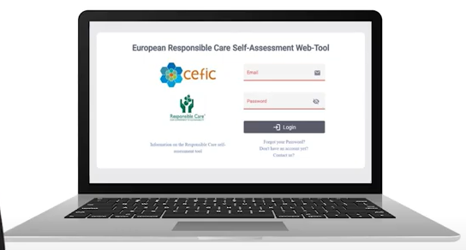





Seven goals of the Webtool
Attractive and simple
Self assess
Learning and progress
Collaborative
Linked to highest possible standards
Benchmarking
Continuous improvement

Slide 5
Update on the use of the RC webtool in Europe (for manufacturers)
635
475
Only 50 submitted the 2023 assessment out of 774!

Slide 6
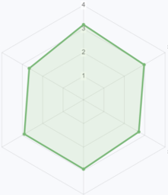
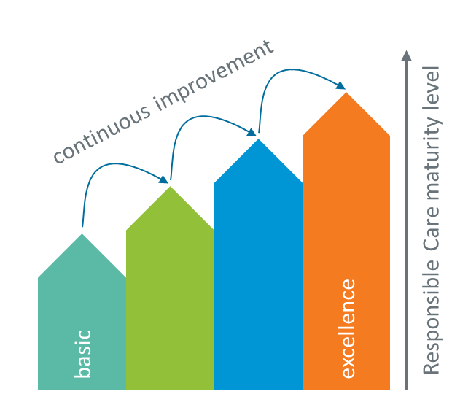
General Outcomes at European level 2022
Outcomes are based on:
1
The Responsible Care Global Charter
A Corporate Leadership Culture: 3,2
4
3
Contributing to Sustainability: 2.71
2
Safeguarding People and the Environment: 2,98
6
2
1
Engaging Stakeholders: 2,92
3
Strengthening Chemicals Management Systems: 2.8
5
…and the 4 maturity levels
4
Influencing Business Partners: 2,95
Overall score: 2.92
(min. 1 – max. 4)
1
2
3
4

Slide 7
New features and functionalities of the RC webtool now online: introduced in 2022
The sites can:
Export all reports in Excel and PDF
Export all reports of the General outcome or of benchmarking together with a single click
Export the Questionnaire in Excel to share it with colleagues
Easily identify chapters, subchapters, questions and replies as they were numbered
Search inside the questionnaire to easily find a question/reply
Change the language of the assessment inside the assessment area (without going to “my profile”); the language will be immediately changed (without the need to log out and login again);
Visualize an icon close to the replies that were prefilled by a ISO prefill (with the info on which was the ISO) or by the HQ prefill;
Visualize which questions were prefilled by a given ISO prefill or by the HQ prefill by going to the “Start and prefill” area of the assessment and by clicking on the button “Questions linked to standards” or “Questions linked to the HQ”
Visualize an introduction and/or comments to specific questions made by the HQ in the HQ prefill
Be able to cancel the selection of a reply to a given question or cancel the replies given in another chapter
Find easily the “Save button” for the replies given that is highlighted in green now. By default, once saved the user is moved to the following subchapter, but there is the possibility to change this option in “my profile” and then manually move between the subchapters using arrows.
Visualize two colorful graphical representations of the general outcome SDGs
Change the order of the table of the General outcome SDGs and export it in the new order
Visualize and export the selected reply in the General outcome questions

Slide 8
In addition to the previous functionalities, the HQs can:
Prefill the HQ assessment based on ISO standards or the previous year assessment
Write an introduction to the corporate assessment (HQ prefill) and/or comments to single questions that will be visualized by the sites
In addition to many of the previous functionalities, the NAs can:
Export into Excel a comparison report (comparing data of their member companies by size and sector, in case of NA of producers) in the General outcome area
Export the graphs of the score evolution over time and status of the business into PDF
Visualize the status of the assessment per month and per year
Export into Excel the info on the assessments of their member companies in the homepage. They can also visualize in the top bar of this section the total number of companies in the tool per given year and the total number of companies that have started the assessment, that they are in progress, or they have submitted it.
New functionalities to be implemented by December 2023 for the site and HQ accounts:
possibility to print or store the comments
possibility to visualize the evolution of the scoring over time

Slide 9

Thank you for joining us!
For further information about Responsible Care please contact:
Giulia Casasole, Responsible Care Manager
gca@cefic.be

