Slide 1

EU27 Chemical Industry: Latest Developments:
Slight upturn in output in contrast to weak demand and high energy prices
^{5th} September 2024
Dr Moncef Hadhri
Economic Affairs
mha@cefic.be

Slide 2
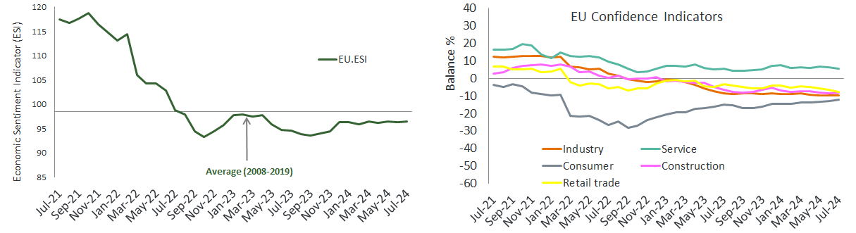
Economic sentiment broadly stable in the EU27 area
Amongst the largest EU economies, the ESI deteriorated markedly in France and Poland,
while it improved strongly in Spain and, less so, in Italy.
Source: EU Commission business and consumer survey results: Answers obtained from the surveys are aggregated in the form of balances, constructed as the difference between the percentages of respondents giving positive and negative replies.
Notes:
In July 2024, the Economic Sentiment Indicator (ESI) remained broadly stable in both the EU. The ESI's sideward trend resulted from decreases in services and retail trade confidence, offset by improved confidence in construction and among consumers. Confidence in industry remained broadly stable. Amongst the largest EU economies, the ESI deteriorated markedly in France and Poland, while it improved strongly in Spain and, less so, in Italy. Economic sentiment remained broadly stable in Germany and the Netherlands. Industry confidence remained broadly stable, as an improvement in managers' production expectations was offset by a decrease in their assessment of the current level of overall order books. Managers’ assessment of the stocks of finished products remained broadly stable. Of the questions not entering the confidence indicator, managers’ assessment of developments in past production edged up, while their assessment of export order books plummeted.

Slide 3
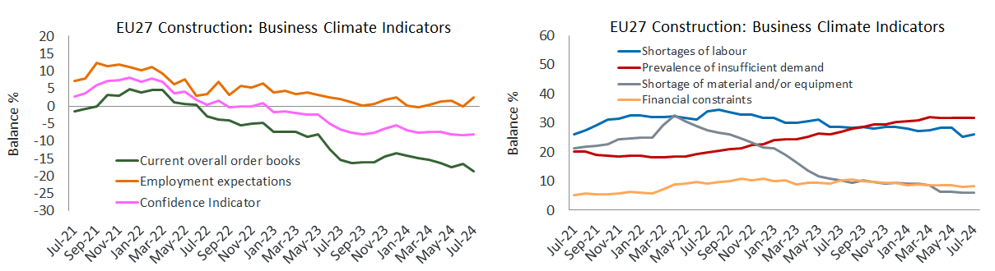
EU27 construction confidence improved slightly
The percentage of construction managers indicating insufficient demand as a factor
limiting construction activity remained high
Source: EU Commission business and consumer survey results: Answers obtained from the surveys are aggregated in the form of balances, constructed as the difference between the percentages of respondents giving positive and negative replies.
Notes:
Construction confidence improved slightly (+0.4) as a marked increase in builders’ employment expectations was almost offset by a strong deterioration in their assessment of the level of order books. The percentage of construction managers indicating insufficient demand or material/equipment shortages as a factor limiting construction activity remained broadly stable. The percentage of construction managers indicating labour shortages or financial constraints as limiting factors increased (by, respectively, 0.9 points to 26.1%, and 0.4 points to 8.3%).

Slide 4
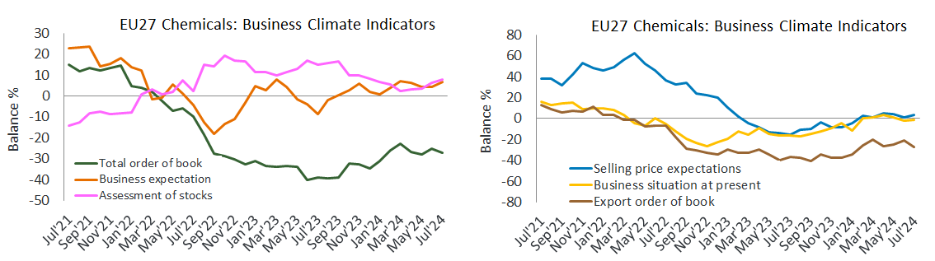
The current level of overall order books decreased slightly in July 2024
The EU27 chemicals business environment shows slight downturn, and is still facing a
limited demand since March 2022
Source: EU Commission business and consumer survey results: Answers obtained from the surveys are aggregated in the form of balances, constructed as the difference between the percentages of respondents giving positive and negative replies.
Notes:
The current level of overall order books shows a slight deterioration in July
The managers’ opinion on the current level of overall order books shows a slight downturn in July 2024 compared to June 2024. It is still in negative digits reflecting the lack of demand for the chemical industry. The ongoing destocking trend came to the end since March 2024. We see in July 2024 the fourth upturn in the stock level after six months of decline. Data on managers’ production expectations shows a slight improvement in July after three months of decline. According to the latest EU27 business and consumer survey, the uncertainty indicator decreased in July. Managers' uncertainty about their future business situation in services and construction and consumers' uncertainty about their future financial situation decreased. By contrast, business uncertainty increased slightly in industry and retail trade. To sum up, the EU27 chemicals business environment shows slight downturn, and is still facing a limited demand since March 2022. The recovery is more necessary than ever.

Slide 5
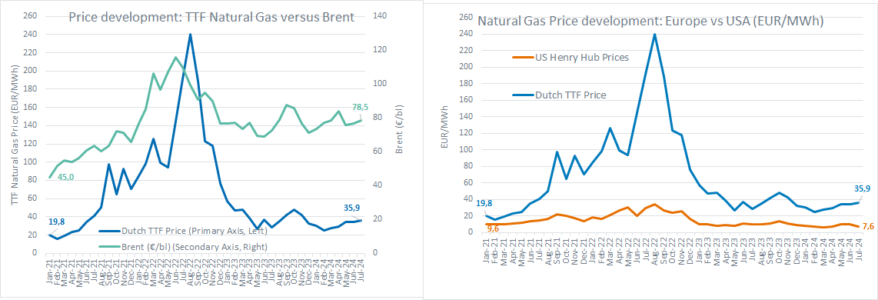
European gas prices(July 2024): 4.7 times higher than in the USA
The chemical industry is energy-intensive and therefore highly impacted by gas prices. In 2022 and 2023, EU27
chemical production fell by more than 6%, and 2024 is not yet showing strong signs of a recovery.
Source: : ICE Dutch TTF Natural Gas Futures Historical Prices - Investing.com and INSEE Oil Prices data
Notes:
European gas prices (July 2024): 4.7 times higher than in the USA
The chemical industry is highly impacted by gas prices. The current gas prices (Jan-July 2024) are 70% above the pre-crisis level (2014-2019). Compared to the USA, the gas price in Europe (July 2024) remains 4.7 times higher. This leaves Europe at a competitive disadvantage with the USA (among others). 2022 gas prices were more than spectacular. Consequently, EU27 chemical production was immediately impacted by the high energy costs. The figures speak for themselves: 2022 and 2023 reported a severe output decline of more than 6%, and 2024 is still showing a slow improvement, and has not yet shown strong signs of a recovery. Europe must act urgently and find solutions to its structural energy problem. Policies adding costs on top intended to boost transformation could speed up EU deindustrialisation and boost import dependencies.

Slide 6
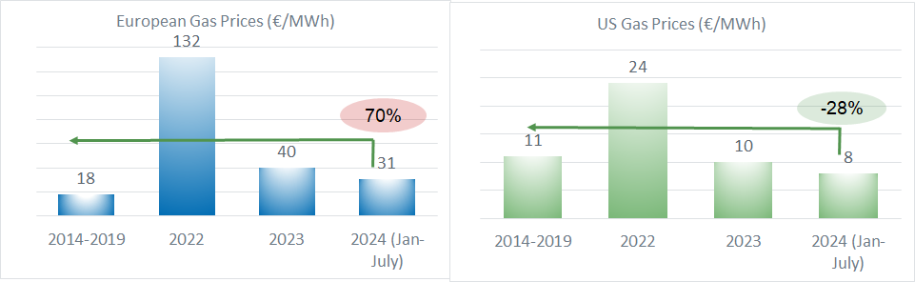
European gas prices in 2024 (Jan-July): 70% above the pre-crisis levels (2014-2019)
Europe must find solutions to its structural energy problem. Policies adding costs on top intended to boost
transformation could speed up EU deindustrialisation and boost import dependencies.
Source: : ICE Dutch TTF Natural Gas Futures Historical Prices - Investing.com and INSEE Oil Prices data
Notes:
European gas prices (July 2024): 4.7 times higher than in the USA
The chemical industry is highly impacted by gas prices. The current gas prices (Jan-July 2024) are 70% above the pre-crisis level (2014-2019). Compared to the USA, the gas price in Europe (July 2024) remains 4.7 times higher. This leaves Europe at a competitive disadvantage with the USA (among others). 2022 gas prices were more than spectacular. Consequently, EU27 chemical production was immediately impacted by the high energy costs. The figures speak for themselves: 2022 and 2023 reported a severe output decline of more than 6%, and 2024 is still showing a slow improvement, and has not yet shown strong signs of a recovery. Europe must act urgently and find solutions to its structural energy problem. Policies adding costs on top intended to boost transformation could speed up EU deindustrialisation and boost import dependencies.

Slide 7
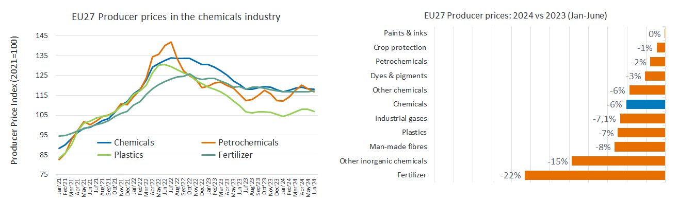
EU27 chemicals prices, down by 6.0% in 2024 (Jan-June)
Fertilizers reported the largest drop of producer prices for the first half of 2024 compared to the same period of 2023 (-22%), followed by other inorganics chemicals (-15%) and ma,-made fibres (-8%).
Source: Eurostat and Cefic Analysis 2024

Slide 8
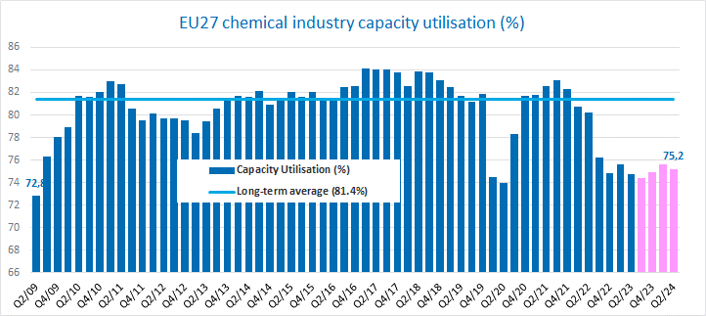
EU27 chemicals capacity utilisation slightly down in Q2-2024
The current level of capacity is still well below the long-term average of 81.4%.
Source: Eurostat and Cefic Analysis 2024
Notes:
EU27 chemicals capacity utilisation slightly down in Q2-2024
EU27 Capacity utilisation has shown encouraging signs during Q4-2023 and Q1-2024. The chart below reports an increase of capacity in the EU27 chemical industry from 74.4% in Q3-2023 to 75.6% in Q1-2024. However, the second quarter of 2024 showed a small decrease of capacity which reached the value of 75.2%. The current level of capacity is still far below the long-term average of 81.4%.

Slide 9
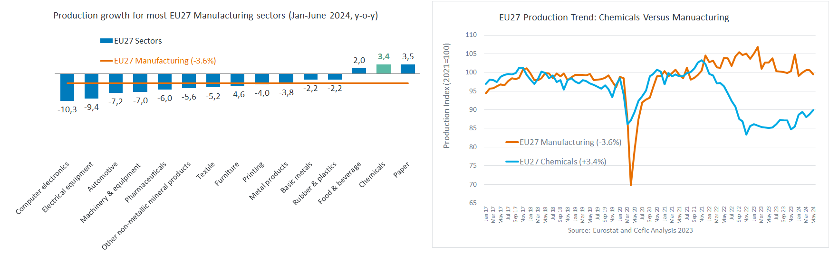
EU27 chemical industry output outperforms other EU27 manufacturing sectors (1H-2024)
The construction and automotive markets are still struggling; in particular, there are concerns for possibly low
production levels in the second half of 2024 and 2025 for cars and electric vehicles.
Source: Eurostat and Cefic Analysis 2024

Slide 10
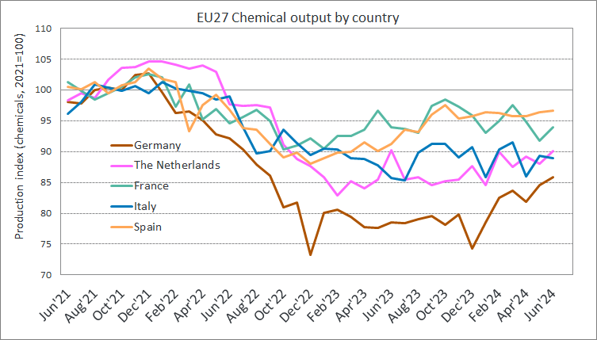
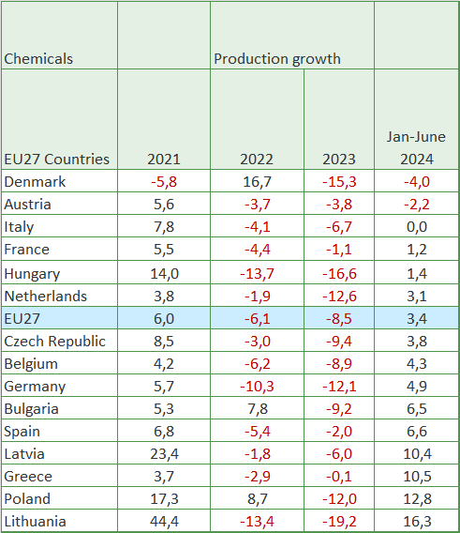
Main EU27 countries showed better production results in 2024 (Jan-June)
These encouraging numbers of chemicals should be taken with a grain of salt, given that their benchmark
is 2023: a year where production was still far below pre-covid levels.
Source: Eurostat and Cefic Analysis 2024
Notes:
One third of EU27 chemicals sales was attributed to Germany (33%, data 2023). Data analysis shows a patchy situation across EU27 Member States: chemicals production grew in Germany (4.9%) in 2024, and Belgium (4.3%) compared to 2023 (Jan-June). The growth in Spain (6.6%) is even higher. The growth in the Netherlands (3.8%) is significant and slightly above the EU27 growth. With 1.2%, France showed a modest growth. Apart from Italy (zero growth) and a few other Member States, the chemical industry in the largest EU economies started the new year better than expected. The significant increase in chemical volumes throughout the first six months of 2024 (+3.4%, y-o-y) should be interpreted with a lot of cautions. A lack of orders and cost problems continue to impact the mood among European chemicals companies.

Slide 11
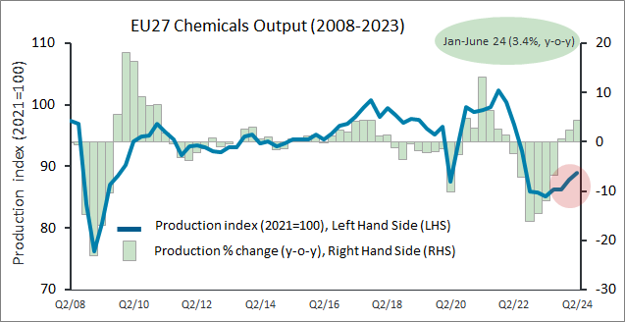
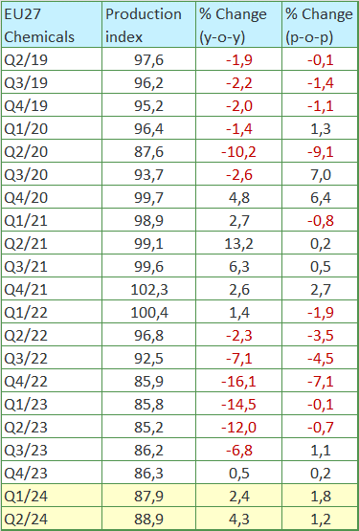
EU27 chemicals production is following its slow recovery
The EU27 chemical industry seems to have reached its ultimate low in Q2-2023. However, given the lack
in demand growth, the European chemical industry production volumes are still not completely recovering.
Source: Eurostat and Cefic Analysis 2024

Slide 12
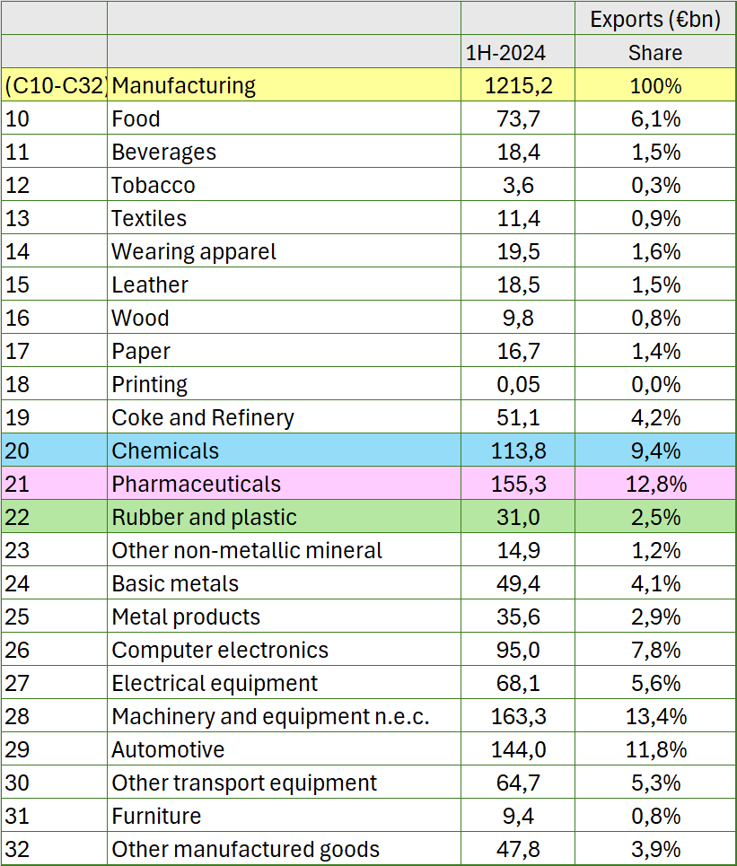
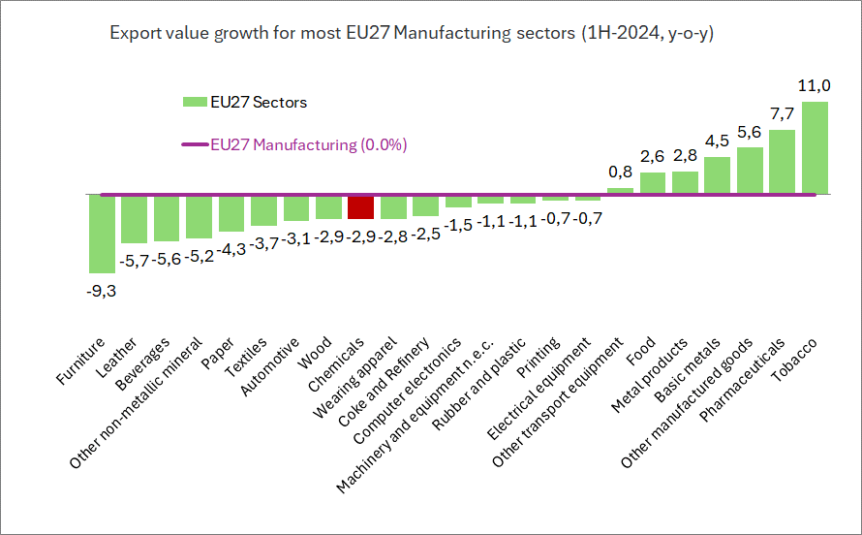
EU27 chemicals exports (€bn) down by about 3% in 1H-2024
Source: Eurostat and Cefic Analysis 2024

Slide 13
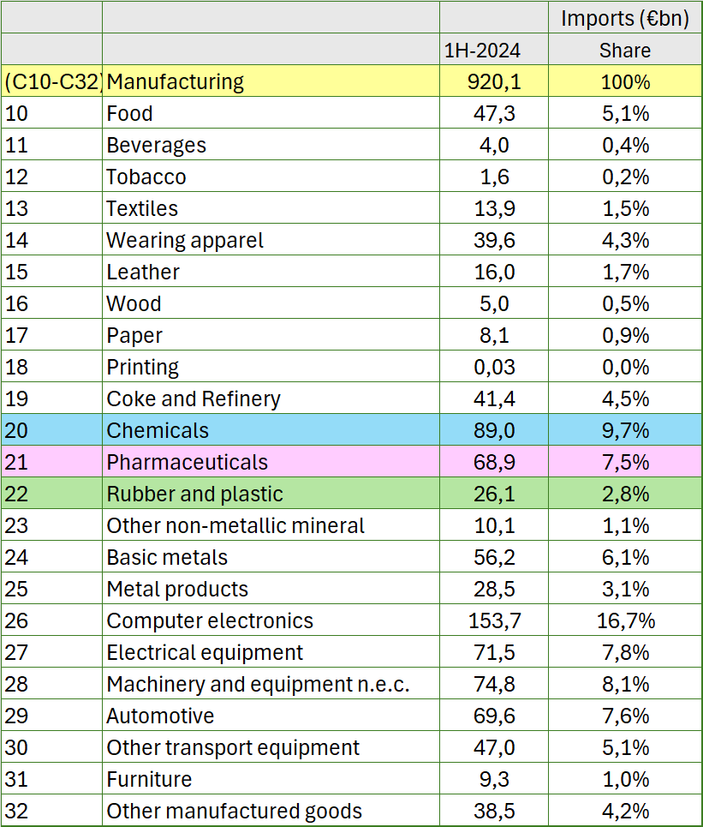
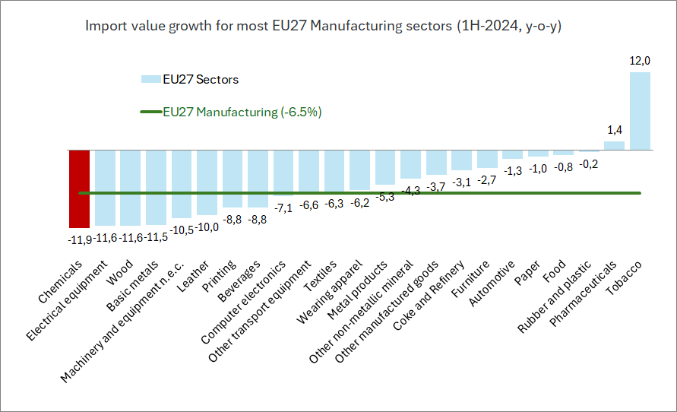
EU27 chemicals imports (€bn) down by 12% in 1H-2024
Source: Eurostat and Cefic Analysis 2024

Slide 14
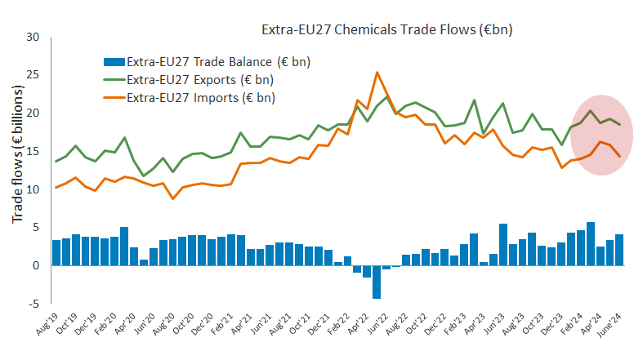
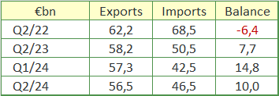
EU27 chemicals trade surplus (€bn) up by 54% in 1H-2024
Trade surplus up by €8.7 bn (1H-2024 vs 1H-2023)
Taking into account the first six months of 2024, trade surplus increased by €8.7 billion compared to the first half of 2023 (+54%).
Source: Eurostat and Cefic Analysis 2024

Slide 15
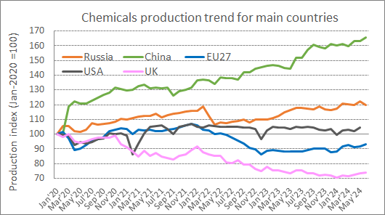
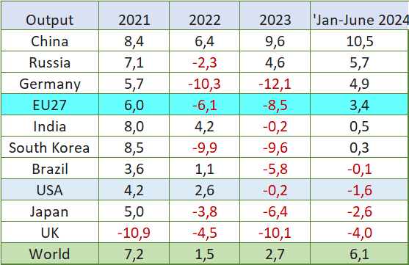
Global chemicals production, up by 6.1% in 2024 (Jan-June)
The global outlook for 2H-2024 is really mixed: The market concerns are now the ongoing weakness of consumer consumption in China, soft trends in automotive (especially EVs) and soft landing in the USA.
Source: Eurostat and Cefic Analysis 2024

Slide 16
Slight upturn in output in contrast to weak demand and high energy prices
Production of the EU27 chemical sector increased for the fourth consecutive quarter since Q3-2023. The EU27 chemical industry seems to have reached its ultimate low in Q2-2023. However, given the lack in demand growth, the European chemical industry production volumes are still far from the pre-Covid levels.
Energy is still more expensive than before the crisis and not competitive on a global scale. EU gas prices – currently 4.7 times higher than the USA – need to decrease, and overall business confidence in the chemical industry needs to improve.
Demand is weak. Incoming orders decline as downstream industry in Europe remains weak. Considering the weaker external demand , most EU manufacturing sectors are facing decreasing trade activity levels.
Looking ahead, the global outlook for the second half of 2024 is really mixed: The market concerns are now the ongoing weakness of consumer consumption in China, soft trends in automotive (especially EVs) and soft landing in the USA. Some analysts believe that we should see an improvement after summer. Others think that recovery is still some way off and the demand increase will be limited as economic conditions seem to be weak in Germany and in the USA, and the situation remains unchanged in China.

